Slide 1
Industrial Practice
Anwar Cement Sheet Limited

Slide 2
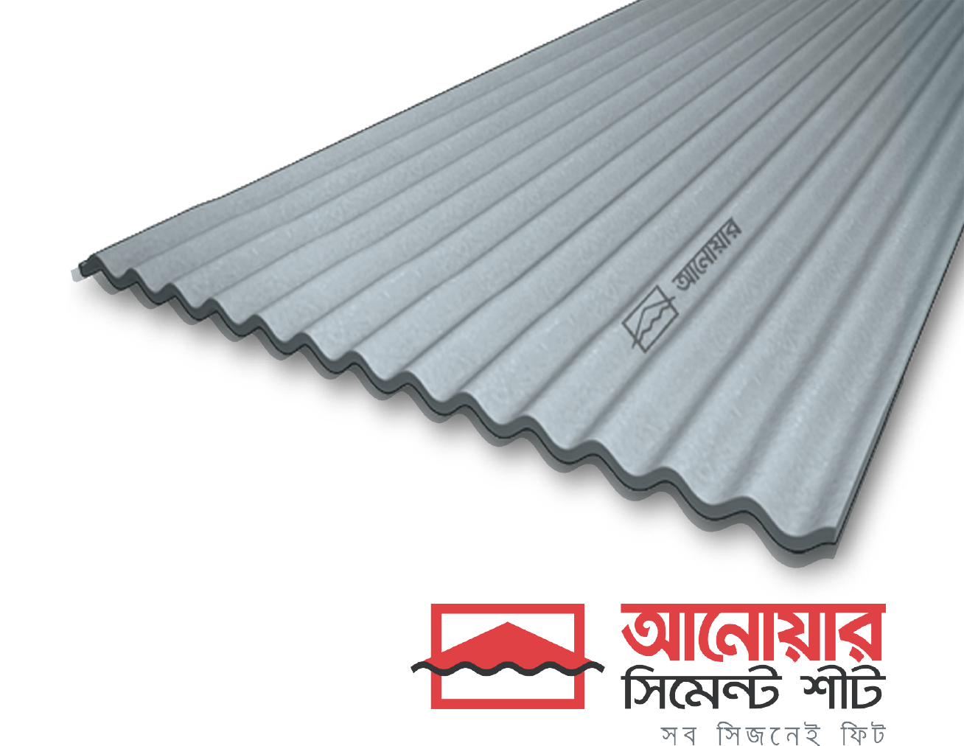

Group Members
Ashiqur Rahman Khan ID-201736004
Masum Mushfiq Dolon ID-201736011
Nazmus Shakib ID-201736029
Lipa Akter ID-201736009
MD. Niamul Ahsan ID-201736015
Shariful Islam ShiShir ID-201736042
Military Institute of Science and Technology

Slide 3
About Anwar Cement Sheet

Slide 4
History
Anwar Group of Industries
Since 1834
Since 2014
Ivory Comb and Button Manufacturing Network
Cement Sheet Manufacturing

Slide 5
Products
Plane Cement Sheet
Cement Mold
Anwar Cement Sheet
Corrugated Cement Sheet
Tua

Slide 6
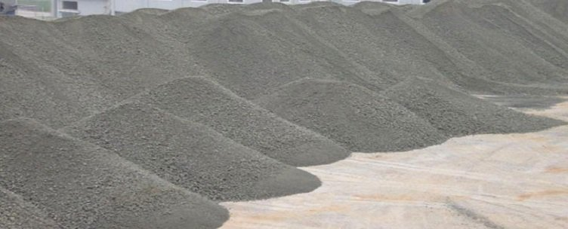
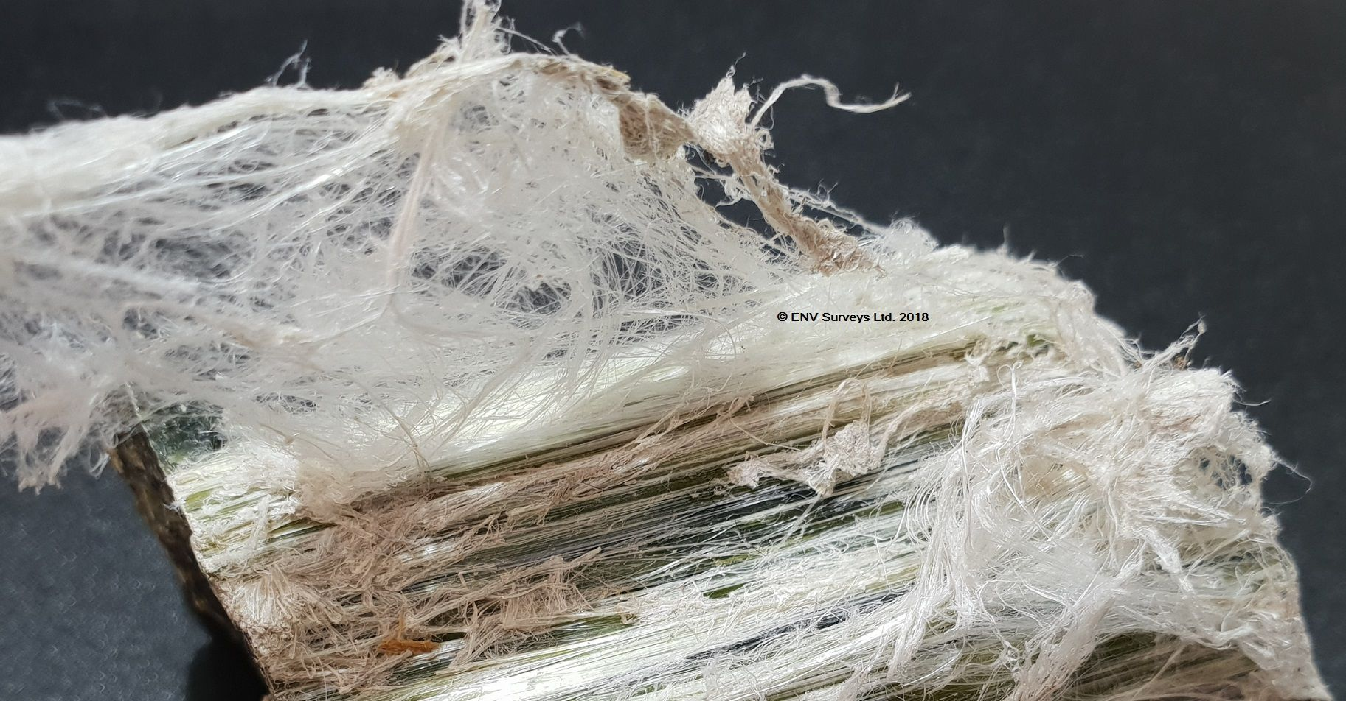
Introduction
Combination of Cement and Reinforcing Fibers
Fig 1: Cement
Fig 2: Asbestos

Slide 7
Why Use Cement Sheet?
Cement sheet | Properties | GI sheet
Thick | Thickness | Thin
Heavy | Weight | Comparatively Light
High | Corrosion Resistivity | Low
High | Fire Resistivity | Low
High | Acid Resistivity | Low
Low | Temperature | High
High | Load Bearing Capacity | Comparatively Low

Slide 8
Raw Materials Preparations

Slide 9
Raw Materials
Binding and Structure
Mineral Fiber-Chrysotile
(12.25%)
Increase Strength
Cement
(86.5%)
Cement Sheet
Glass Fiber-
E Glass Chop
(.25%)
Pulp-Jeans
(1%)
Increase Flexibility

Slide 10
Fiber Preparation
BOD
Fiber Preparation
Vertical Lift
Belt Conveyor
Chrysotile
Bag Pushing Device
Bag Cutter
(Long and Side)
Bag Hooker
Bags
Bucket Conveyor
Fiber Weigh Hopper
Buffer Silo
Edge Runner Mill
Blower
Bag Shredder
Screw Conveyor
Fiber
Slurry Mixing Tank
Dust Collector
Dust
Blender
Lump Crusher

Slide 11
Pulp Preparation
Jeans from Local Garments
Pulp Warehouse
Shredding of Jeans by Cutting Machine
Beater Tank
200 kg pulp
+
1000 liter water
Water
from Cone Tank
SM Tank
Pulp Dozing Tank
Day Tank
Hydro Pulp Tank
1200 liter
water

Slide 12
Cement Preparation
Cone Tank
Water
Screw Conveyor
Cement Silo
Cement Weigh Hopper
SM Tank
Beater Tank

Slide 13
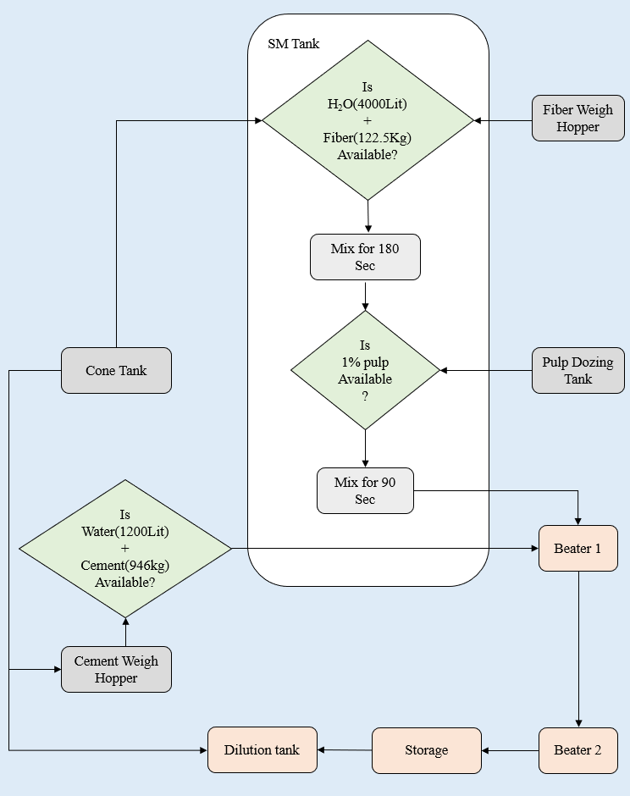
Slurry Mixing Tank

Slide 14
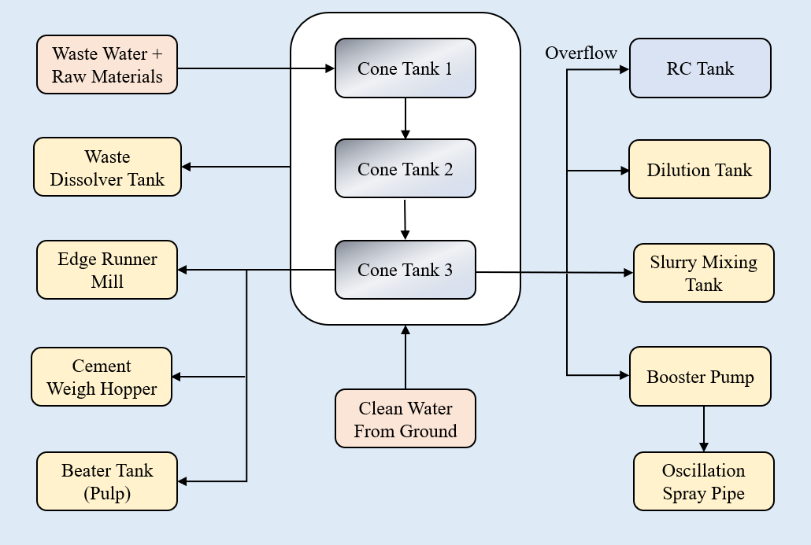
Water Distribution

Slide 15
Cement Sheet Production

Slide 16
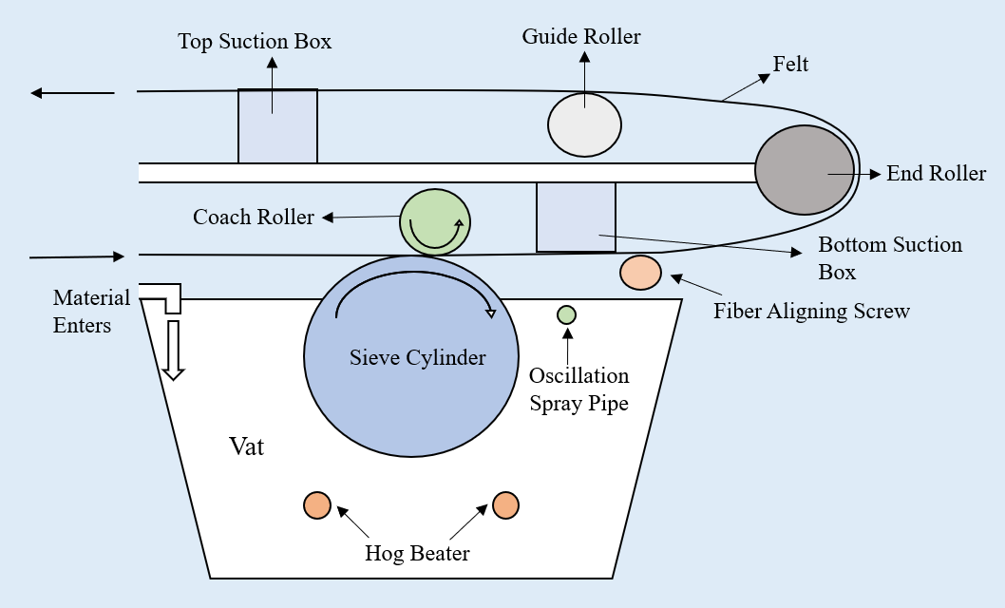
Main Machine

Slide 17
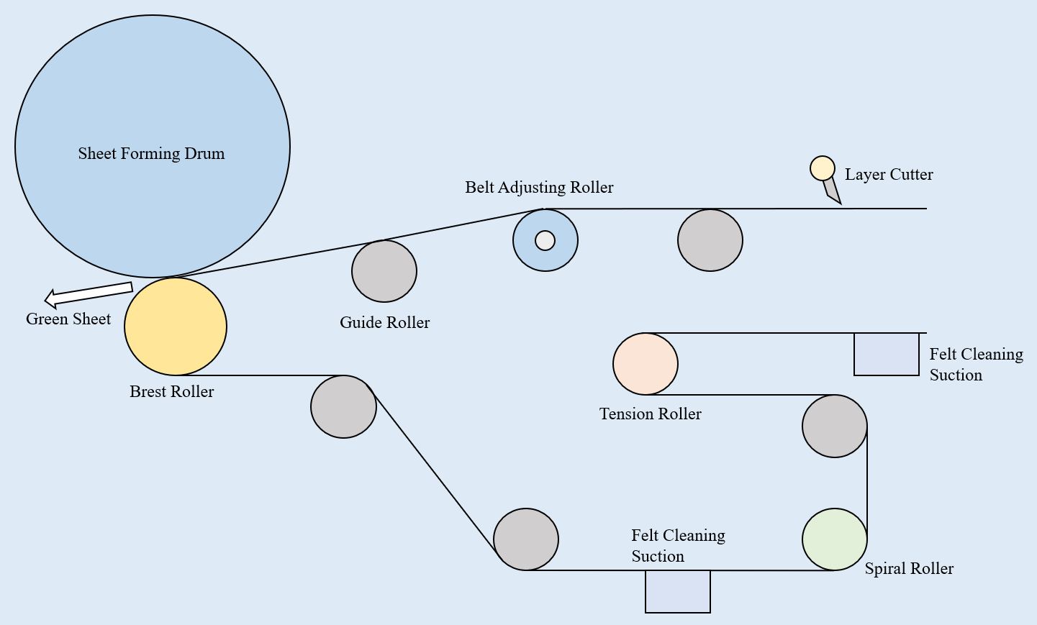
Main Machine

Slide 18
Side Conveyor Section
Conveyor-3
Conveyor-2
Conveyor-1
Cross Cutting
&
Piling
Long Cutting
&
Painting
Passing
the Green
Sheet
Waste
Waste
Waste

Slide 19
Side Conveyor Section
Water
From
Cone Tank
Waste
Waste
Dissolver
Storage
Dilution
tank

Slide 20
Side Conveyor Section
VC Box
Stack of
Green Sheet
& Template
Plane Green
Sheet
Corrugated
Green Sheet
Template
Conveyor-3
Forming Table
Transfer
Car
Transfer
Car
Heating Chamber

Slide 21
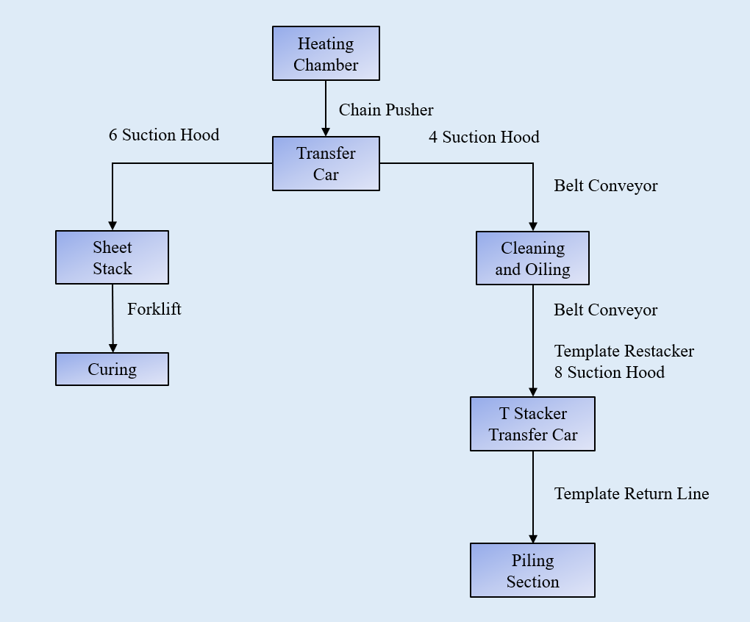
Depiling Section

Slide 22
Quality Control

Slide 23
QC Standards (Fiber)
Characteristics | Value | Standards
Moisture | (35 ± 2) % | ACSL SOP
Buoyancy | 1800 cc | ACSL SOP

Slide 24
QC Standards (Pulp)
Characteristics | Value | Standards
Pulp opening | Full Open | ACSL SOP
Consistency | As per Furnish | ACSL SOP
SR - Value | 22° to 26° | ACSL SOP

Slide 25
QC Standards (Green Sheet)
Characteristics | Value | Standards
Moisture | (35 ± 2) % | ACSL SOP
Density (Dry) | 1.35 ± 0.05 gm/cc | ACSL SOP

Slide 26

QC Standards (Green Sheet)
21 mm
(75 ± 1) mm

Slide 27
QC Standards (Green Sheet)
No. of Corrugation = 14
4 to 10 ft
1065 ± 5 mm

Slide 28
QC Standards (LBC Test)

Slide 29
Recommendations

Slide 30
Limitations
Double Line Production
Frequent Breakdown
Limitations
Overproduction
Analogue Data Collection
No Visual Representation
Low Quality Fiber

Slide 31
Fiber Quality
Limitation
Recommendation
Mixture of Fiber of Different Grades
Chrysotile
Grade 6 Fiber
Low Quality
Low Cost
Parameters
Cost
Grade
Strength
Linear Programming
Optimum Quality
& Cost

Slide 32
Analogue Data Collection
Limitation
Recommendation
Manual Data Collection
Automated Data Collection
Digital Input
CUSUM
EWMA
Visual Representation
Slight Deviations in Process

Slide 33
Overproduction
Limitation
Recommendation
Absence of Proper Market Analysis
Proper Forecasting
4p’s
Product
Price
Place
Promotion
4p’s of Marketing

Slide 34
Frequent Breakdown
Limitation
Recommendation
Schedule Maintenance of Software
Software Breakdown
Breakdown of Whole System
Hardware & Software Integration

Slide 35
Additional Recommendation
Current Situation
Recommendation
Environment of Heating Chamber
120°C Temperature
6 to 7 Bar Pressure
Water Curing
White Marks of Calcium on Cement Sheet
Water Curing With No White Marks
Increased Strength

Slide 36
Additional Recommendation
Addition of Jute Fiber
Addition of Cotton with Jeans
Trial and Error
DOE
For Reducing Cost
For Promoting Local Resource
For Implementing Green Production

Slide 37
Thank You For Your Attention

Slide 38
Any Questions?

